Slide 1
Attention is All You Need Ashish Vaswani, Noam Shazeer, Niki Parmar, Jakob Uszkoreit, Llion Jones,Aidan N. Gomez, Łukasz Kaiser, Illia Polosukhin
31st Conference on Neural Information Processing Systems (NIPS 2017), Long Beach, CA, USA.
Presenter:1090522308 Yung-Han Lee
Adviser:Dr. Chung-Hsien Tsai

Slide 2
Outline
Abstract
Introduction
Background
Model Architecture
Why Self-Attention
Training
Results
Conclusion

Slide 3
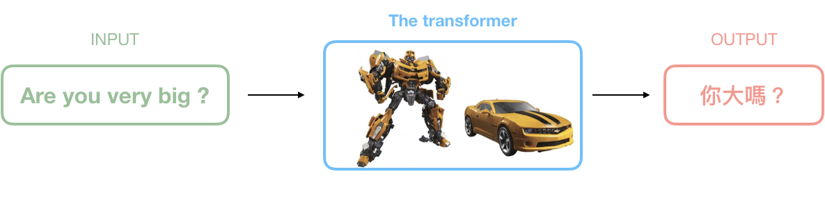
Abstract
The dominant sequence transduction models are based on complex recurrent or
convolutional neural networks that include an encoder and a decoder. The best
performing models also connect the encoder and decoder through an attention
mech-anism. We propose a new simple network architecture, the Transformer,based solely on attention mechanisms, dispensing with recurrence and convolutions entirely. Experiments on two machine translation tasks show these models to be superior in quality while being more parallelizable and requiring significantly less time to train. Our model achieves 28.4 BLEU on the WMT 2014 EnglishtoGerman translation task, improving over the existing best results, including ensembles, by over 2 BLEU. On the WMT 2014 English-to-French translation task,our model establishes a new single-model state-of-the-art BLEU score of 41.0 after training for 3.5 days on eight GPUs, a small fraction of the training costs of the best models from the literature.

Slide 4
1. Introduction
In this work we propose the Transformer, a model architecture eschewing recurrence and instead relying entirely on an attention mechanism to draw global dependencies between input and output.The Transformer allows for significantly more parallelization and can reach a new state of the art intranslation quality after being trained for as little as twelve hours on eight P100 GPUs.

Slide 5
2. Background
The goal of reducing sequential computation also forms the foundation of the Extended Neural GPU
The Transformer is the first transduction model relying entirely on self-attention to compute representations of its input and output without using sequencealigned RNNs or convolution. In the following sections, we will describe the Transformer, motivate self-attention.

Slide 6
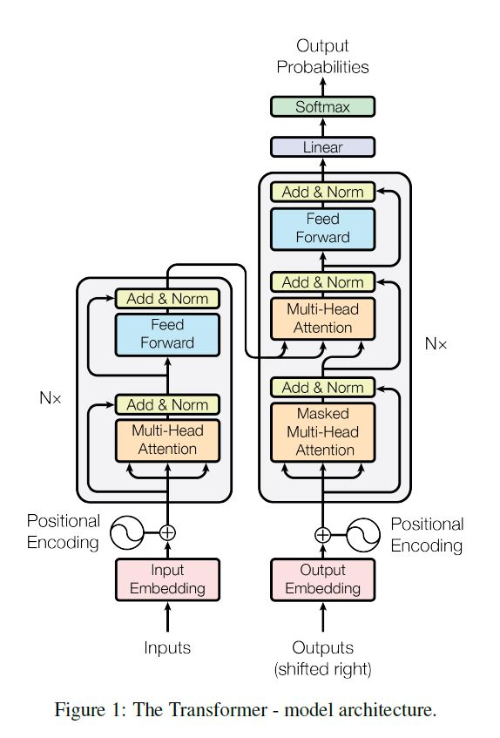
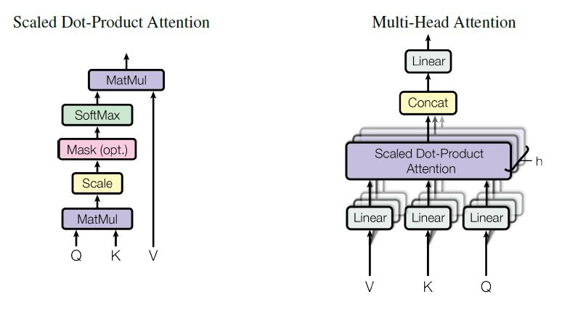


3. Model Architecture
Encoder and Decoder Stacks
Attention
Scaled Dot-Product Attention
Multi-Head Attention
Applications of Attention in our Model
Position-wise Feed-Forward Networks
Embeddings and Softmax
Positional Encoding

Slide 7
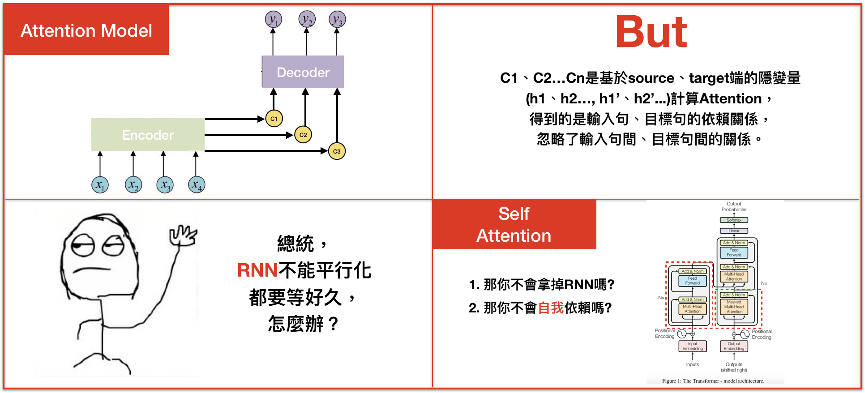
4. Why Self-Attention

Slide 8
5. Training
This section describes the training regime for our models
Training Data and Batching
Hardware and Schedule
Optimizer
Regularization

Slide 9
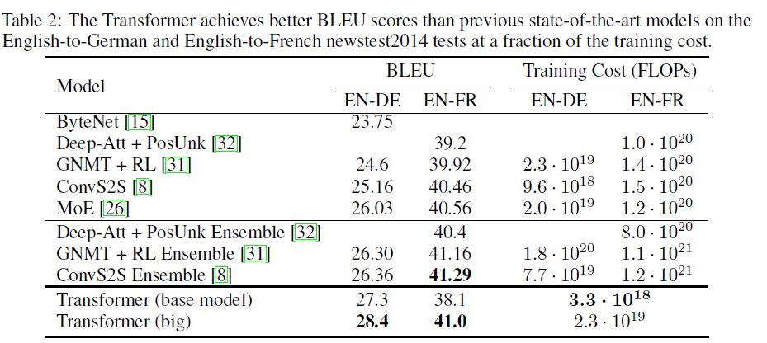
6. Results

Slide 10
7. Conclusion
In this work, we presented the Transformer, the first sequence transduction model based entirely on attention, replacing the recurrent layers most commonly used in encoder-decoder architectures with multi-headed self-attention.
For translation tasks, the Transformer can be trained significantly faster than architectures based on recurrent or convolutional layers. On both WMT 2014 English-to-German and WMT 2014 English-to-French translation tasks, we achieve a new state of the art. In the former task our best model outperforms even all previously reported ensembles.
We are excited about the future of attention-based models and plan to apply them to other tasks. We plan to extend the Transformer to problems involving input and output modalities other than text and to investigate local, restricted attention mechanisms to efficiently handle large inputs and outputs such as images, audio and video. Making generation less sequential is another research goals of ours.

Slide 11
Reference
Transformer - 關於序列建模，是時候拋棄RNN和LSTM了https://bigdatafinance.tw/index.php/news/578-transformer-rnn-lstm
深入學習Google Transformer模型網絡結構
https://kknews.cc/zh-tw/code/xj4p59g.html
Seq2seq pay Attention to Self Attention: Part 2(中文版)
https://medium.com/@bgg/seq2seq-pay-attention-to-self-attention-part-2-%E4%B8%AD%E6%96%87%E7%89%88-ef2ddf8597a4
無所不能的通用計算模型
https://medium.com/@pocheng0118/a-brief-overview-vanilla-transformer-v-s-universal-transformer-無所不能的通用計算模型-d9e89dcef080
基於注意力機制的機器翻譯模型
https://medium.com/@cyeninesky3/attention-is-all-you-need-基於注意力機制的機器翻譯模型-dcc12d251449

Slide 12
END

